Slide 1
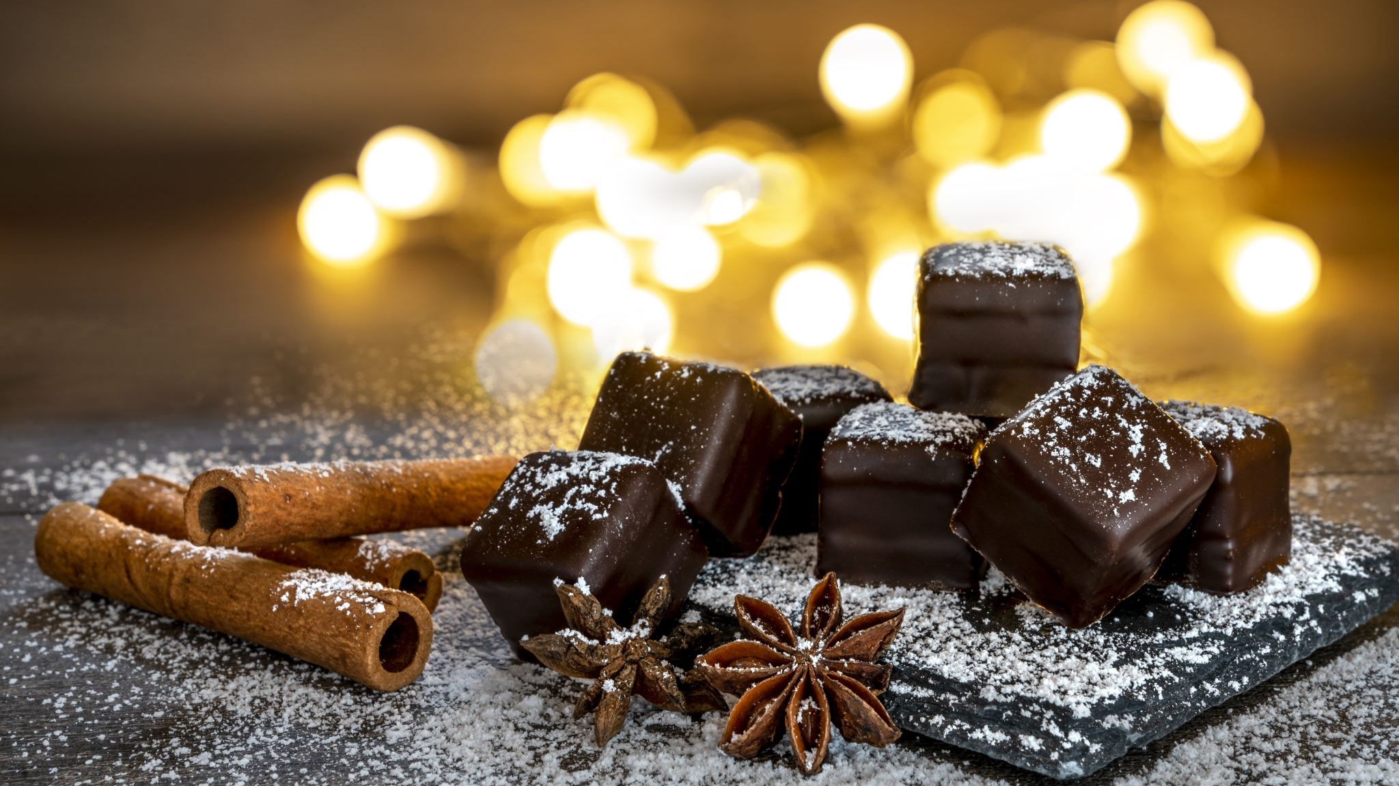
Chocolate Reviews
By Raunak Padore

Slide 2
Background
Why Chocolate? – Cacao first consumed during the Olmec civilization (19th – 11th BCE)
Chocolate Industry was valued at $130.56 Billion(global), $30 Billion (U.S.A) and expected to grow at a compounded rate of 4.6% annually.

Slide 3
Background
Used historically as a mild antidepressant, boosts serotonin(calming effect), releases endorphins (elevate mood) and suppresses cortisol (reduces stress).
Dark Chocolate in mild consumption lowers blood pressure and reduces the risk of heart diseases.

Slide 4
$130 Billion Question(s)
Who (manufacturer) makes the best chocolate?
Where are the best cacao beans coming from?
Which country makes the best chocolate?
What percent of Cocoa has better ratings?

Slide 5
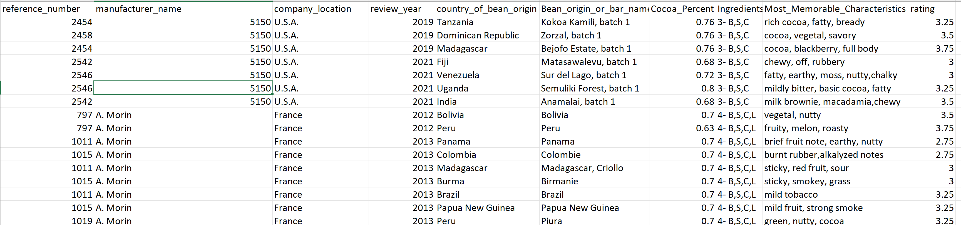
Dataset

Slide 6


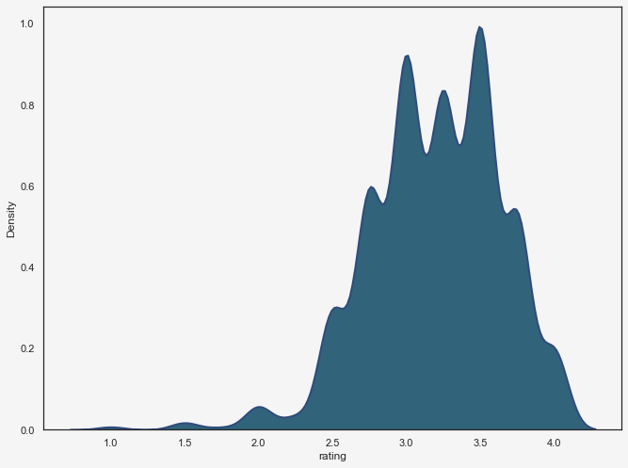

Density of Chocolate Ratings
Total number of ratings – 2530
Mean Score for review – 3.19
Standard Deviation -
First Quartile (Lower 25%) – 3.00
Median – 3.25
3rd Quartile ( Upper 75%) – 3.50

Slide 7
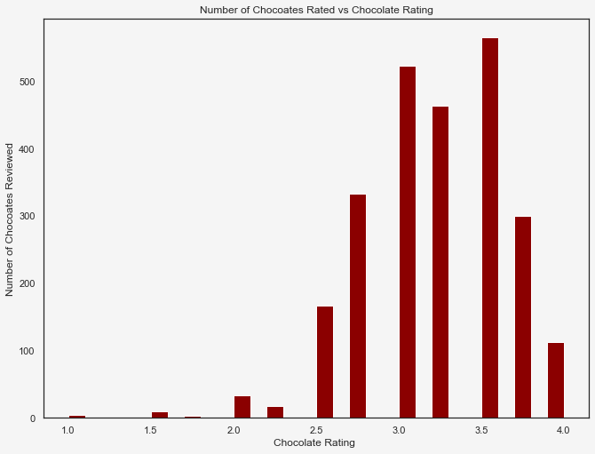
Distribution of Ratings
4.0 = Outstanding
3.5 - 3.9 = Highly Recommended
3.0 - 3.4 = Recommended
2.0 - 2.9 = Disappointing
1.0 - 1.9 = Unpleasant

Slide 8
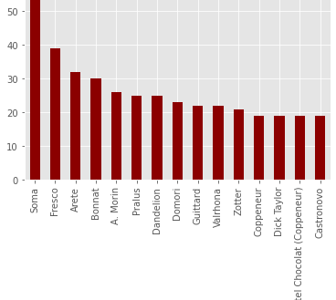
Who (manufacturer) makes the best chocolate?
Sorted and analyzed 15 companies with atleast 18 reviews.

Slide 9
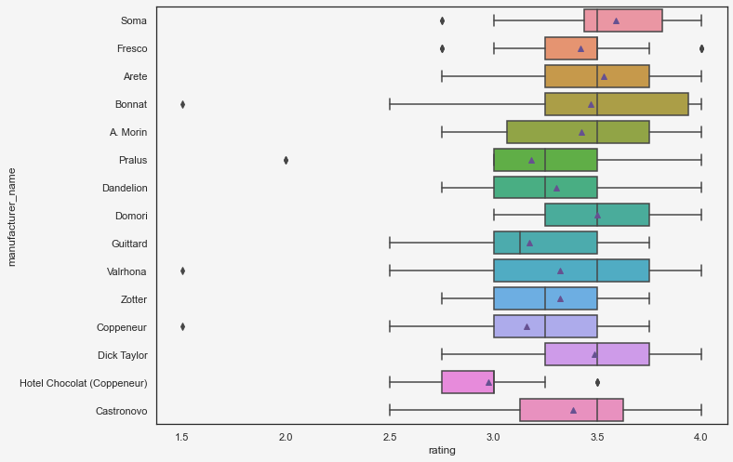
Who (manufacturer) makes the best chocolate?
Soma, Arete, Bonnat, A. Morin, Domori, Valrhona, Dick Taylor and Castronovo all had a median of around 3.5.
Soma had the highest average with an average of 3.59
Hotel Chocolat had the lowest mean with an average of 2.97

Slide 10
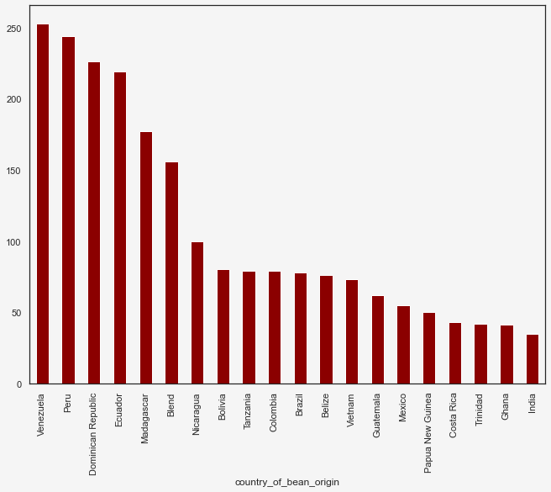
Where are the best cacao beans coming from?
Sorted and analyzed 20 originating location of cacao beans by count of reviews.
Fun Fact!: Over 70% of cacao beans are imported from Africa

Slide 11
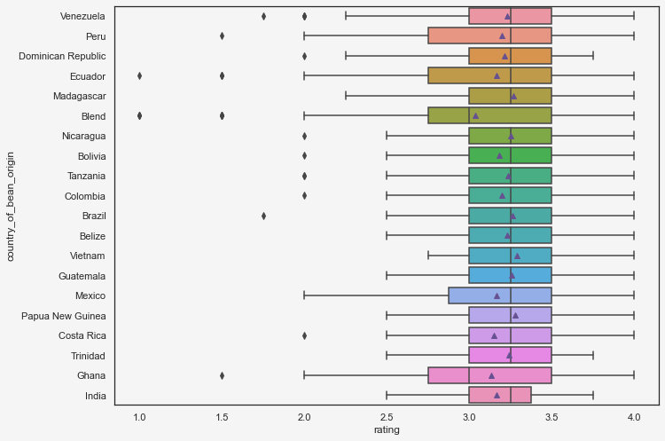
Where are the best cacao beans coming from?
Highest Mean = Vietnam (3.28) , Papua New Guinea (3.278)
Lowest Mean = Blended beans = (3.03)

Slide 12
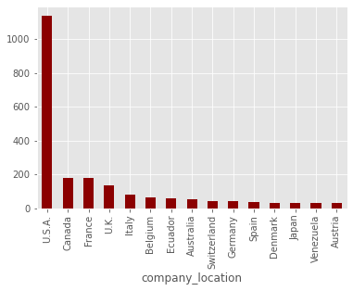
Which country makes the best chocolate?
U.S.A makes the most amount of chocolate. ($30 Billion industry)

Slide 13
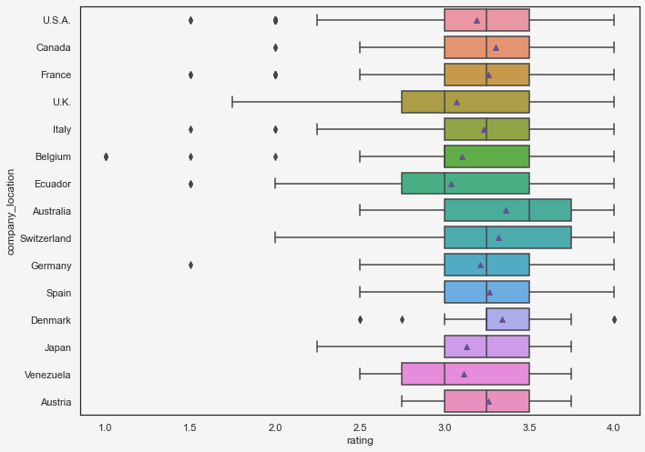
Which country makes the best chocolate?
Highest Mean = Australia (3.36), Denmark (3.33), Switzerland (3.32) Canada (3.30)
Lowest Mean = Ecuador ( 3.04), U.K.(3.07)

Slide 14
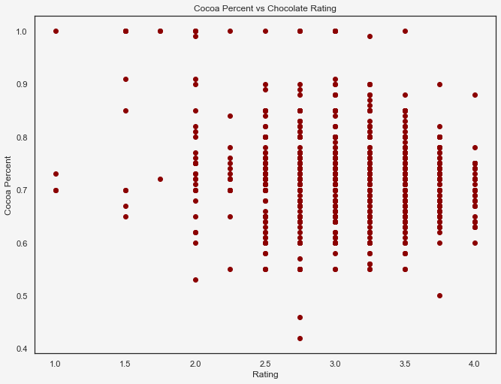
What percent of Cocoa has better ratings?

Slide 15
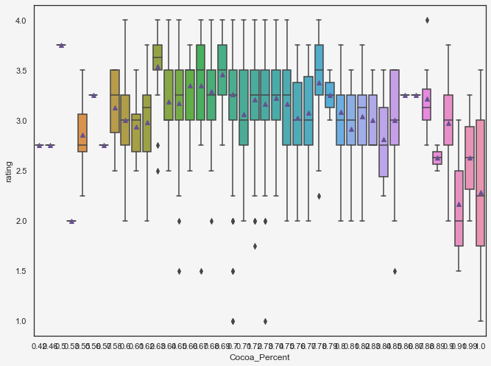
What percent of Cocoa has better ratings?
Lower Percent of chocolate tend to have a higher mean rating.
63 Cocoa Percent has the highest mean rating. (3.54)

Slide 16
Limitations
Data collected does not have the price of the Chocolates. Unable to do a price vs rating analysis. We can assume that higher rated chocolate could cost more.
Data seems to have a lot of American Companies and is not an accurate depiction of the chocolate industry.

Slide 17
Further Analysis
Add a pricing data to understand business implications on Rating.
Build a model to predict rating based on consumer inputs.

Slide 18
Questions?

Slide 19
Thank You!

